Slide 1
Capstone1-E-Commerica
Date:
Presenter: ChrisTsoi

Slide 2
Reducing unit price 10% during Jul/2010-Sep/2014 resulted in increasing the quantity which influenced the sales of each products which requiring identification of unit price and quantity
!
Decreased unit prices which forced to increase the quantity of the products.
Due to the decreased unit prices of products, it doesn’t seem to increase sales
!
Different between the overall sales and the sales of individual product
The overall sales can be extremely high because the volume of the products

Slide 3
Identify the relationship between Unit Price and Quantity can be alleviated by adopting the two proactive statistical approach as descriptive and inferential statistics in Jul/2010-Sep/2014
Identify the relationship between unit price and quantity can be alleviated by adopting the two proactive statistical approach as descriptive and inferential statistics in Jul/2010-Sep/2014
Descriptive Statistics
Inferential Statistics
Provided a boxplot showing the volume sales of customers
A correlation comparison chart which shows the regression between unit price and quantity

Slide 4
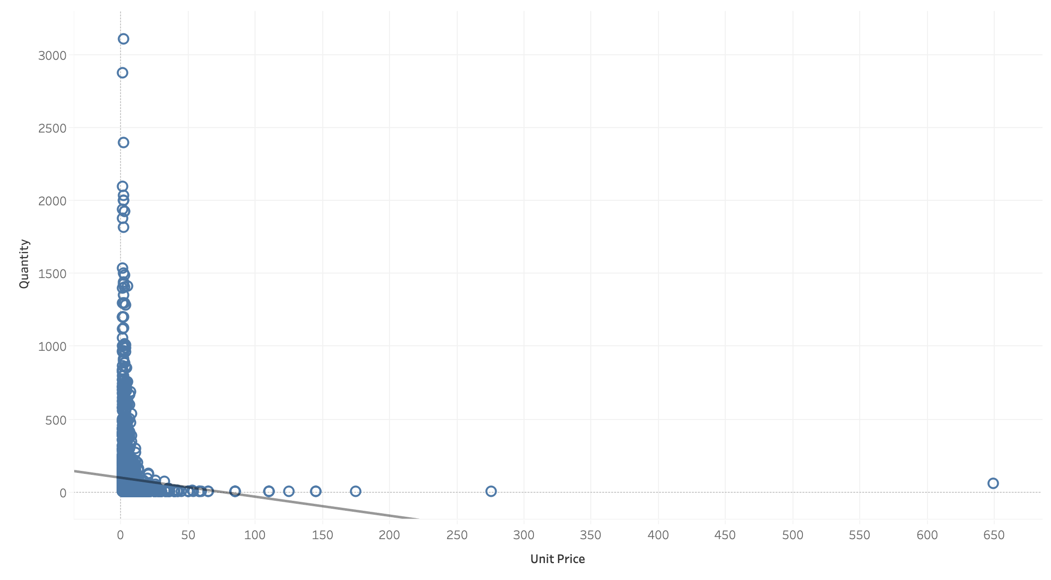
Through using descriptive and inferential statistics, we identified two key variables that how strongly Unit Price and Quantity are correlated.
Key Insights
A chat shows the linear regression between unit price and quantity. As we can see, the linear regression is going downward which means that is negative and that makes sense with the negative correlation.
The trend line represents the linear regression which contains the p-value and R-squared showing the relationship between the quantity and the unit price.
The quantity is decreasing as the unit price is increasing which means customers are willing to consume more if the price of products are lower. In contrast, customers will be spending less if the prices go upward.
Source: Southern Water Corp Statistical Records

Slide 5
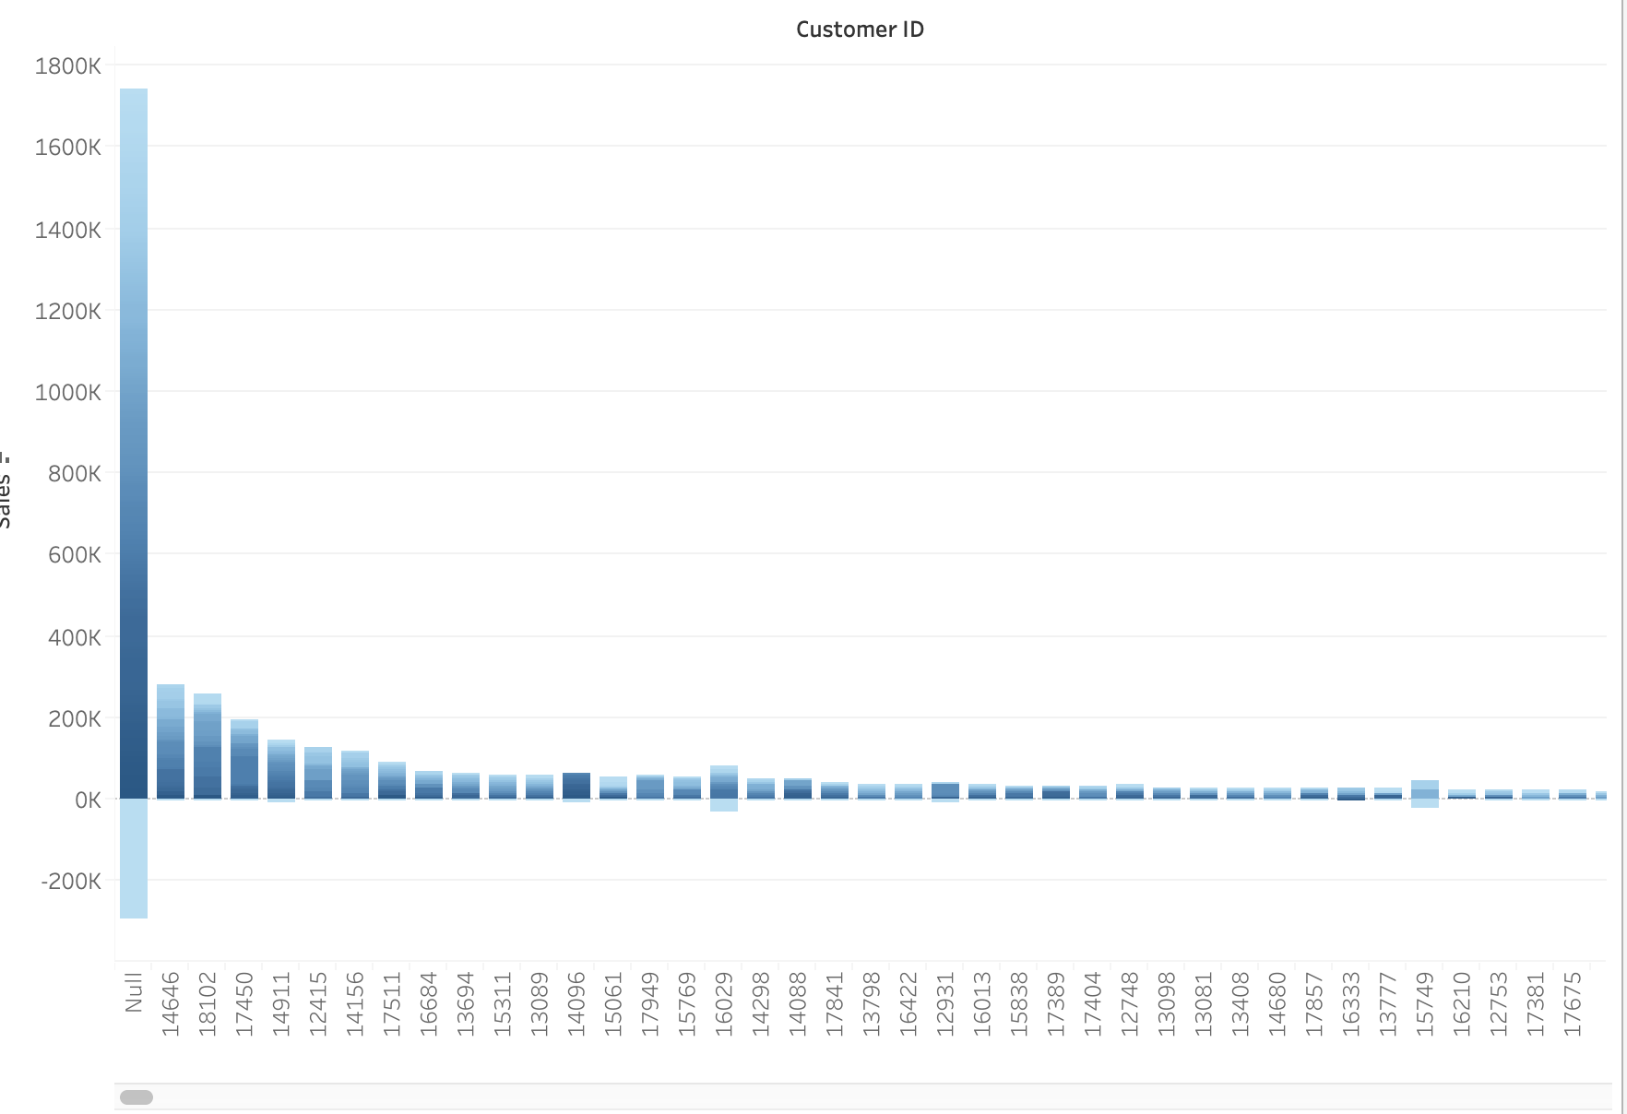
Comparing each order’s sales to the overall’s sales in order to identify the relationship in different level of Unit Price
Key Insights
Each invoice can be contained the small amount of sales even though the overall sales of each customer could be extremely high
We can find that how much customers spent on one order and compared each order of sales to see if which order is contained with the higher or lower sales
The overall sales can be extremely high with the lower prices on each items which means customers can sell multiple orders with different level of unit prices.

Slide 6
Though calculating the Pearson Correlation Coefficient with unit price and quantity which identified how these two variables are related
 | Unit Price & Quantity
Pearson Correlation Coefficient | -0.01502
Key Insights
Creating the Pearson correlation coefficient based on the unit price and quantity variable ended up with a negative number(-0.01502).
(-0.01502) means the correlation between unit price and quantity is a negative correlation.

